Slide 2
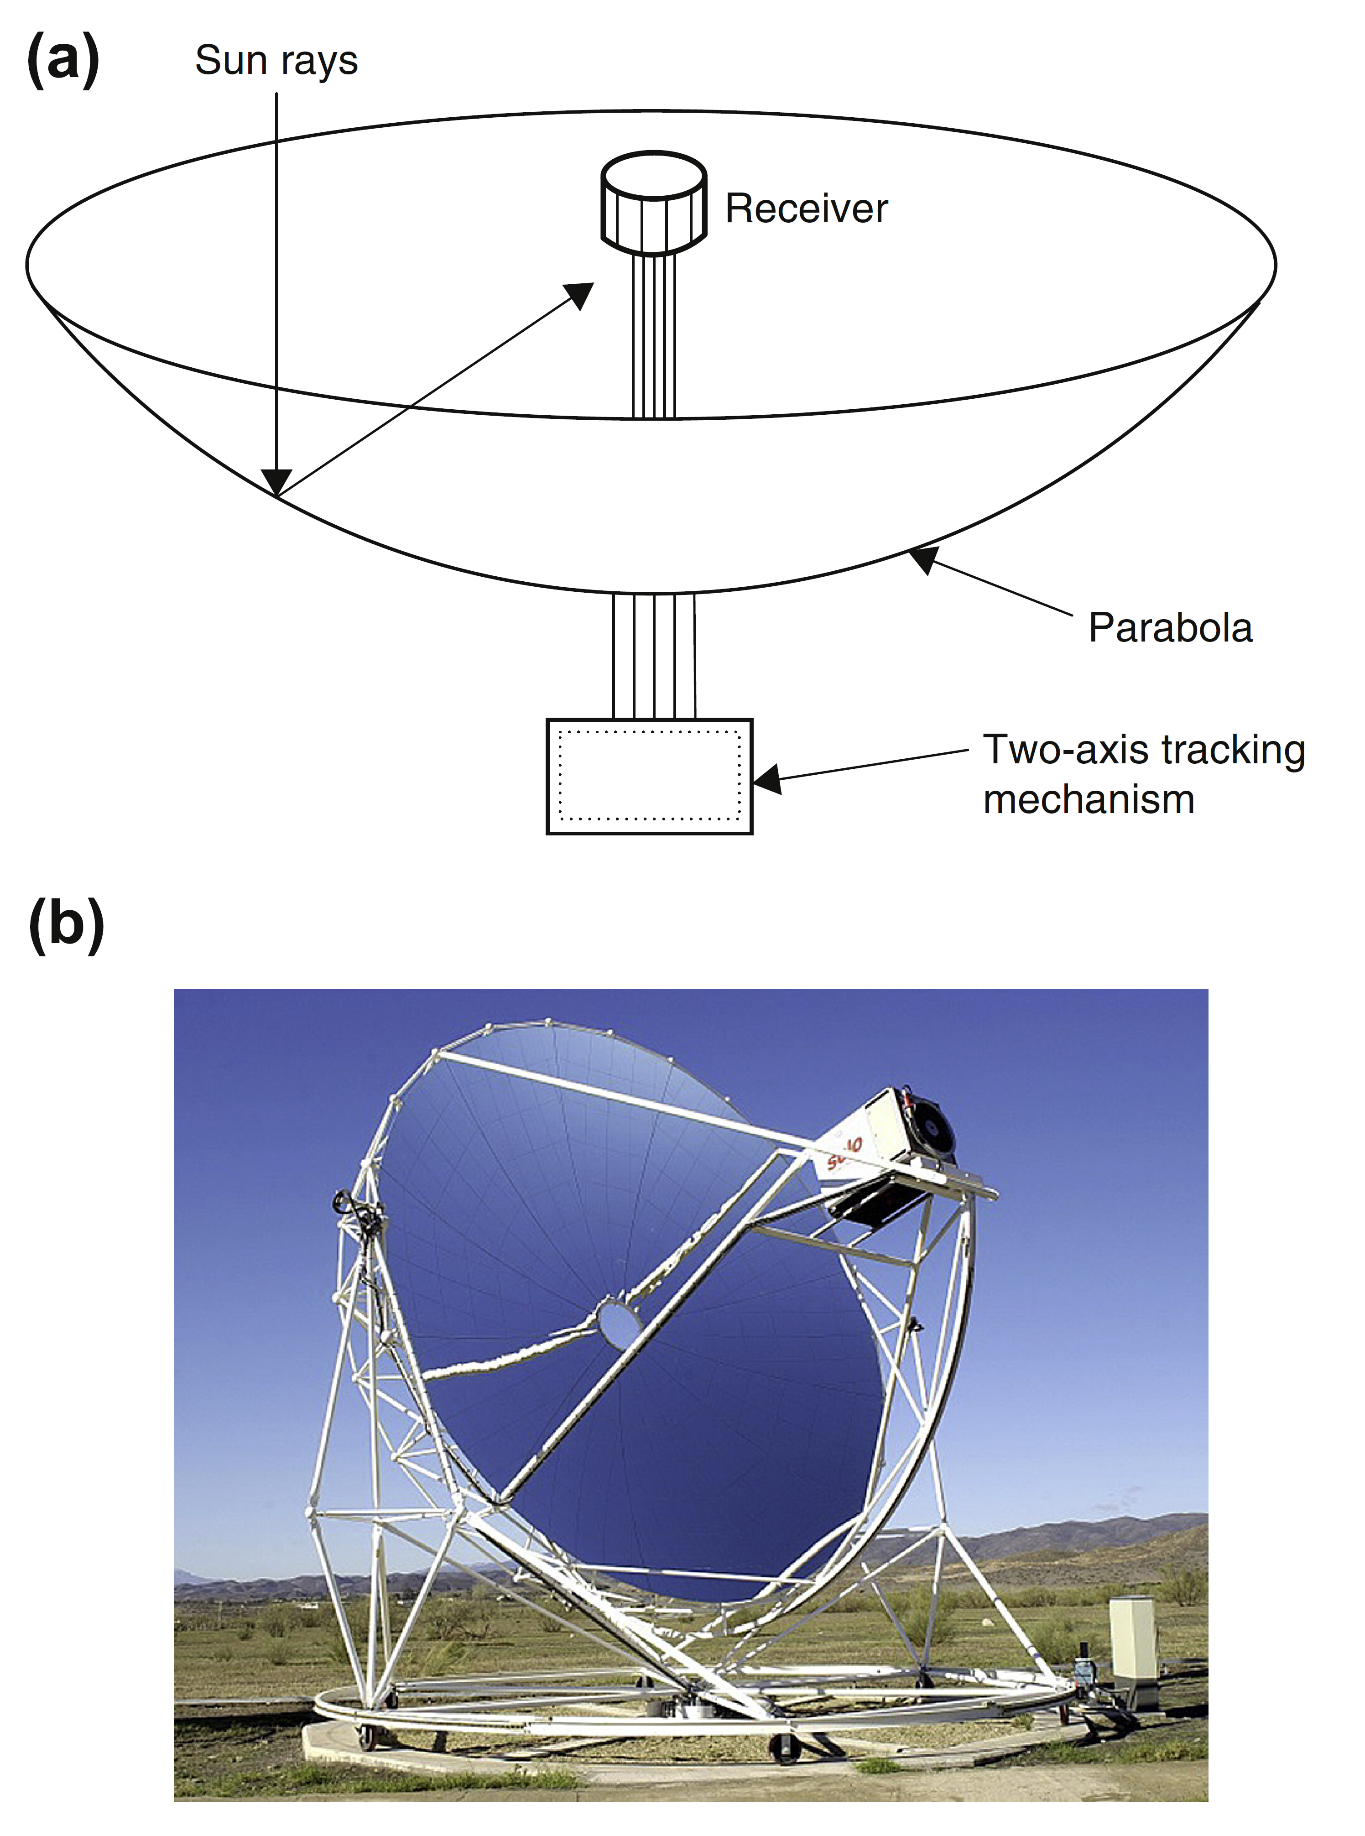
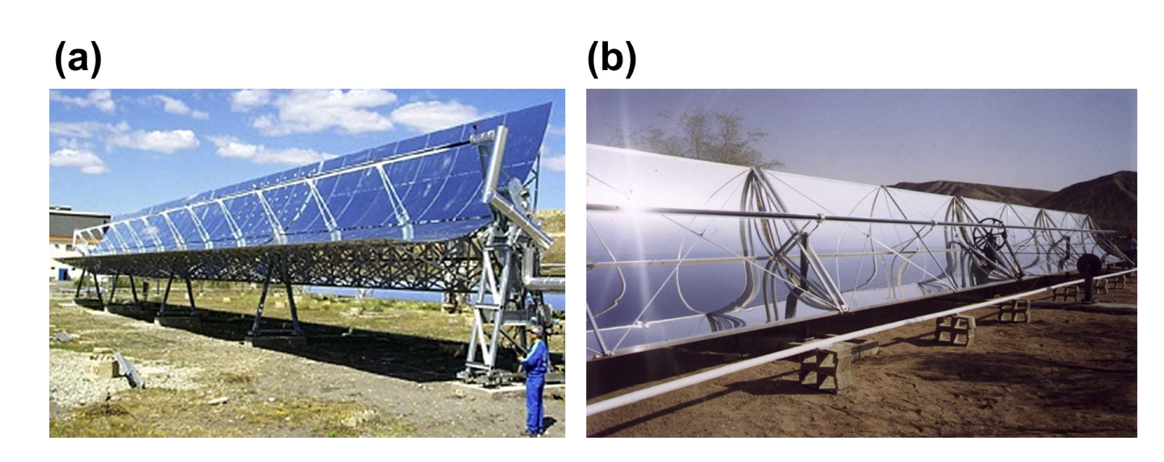
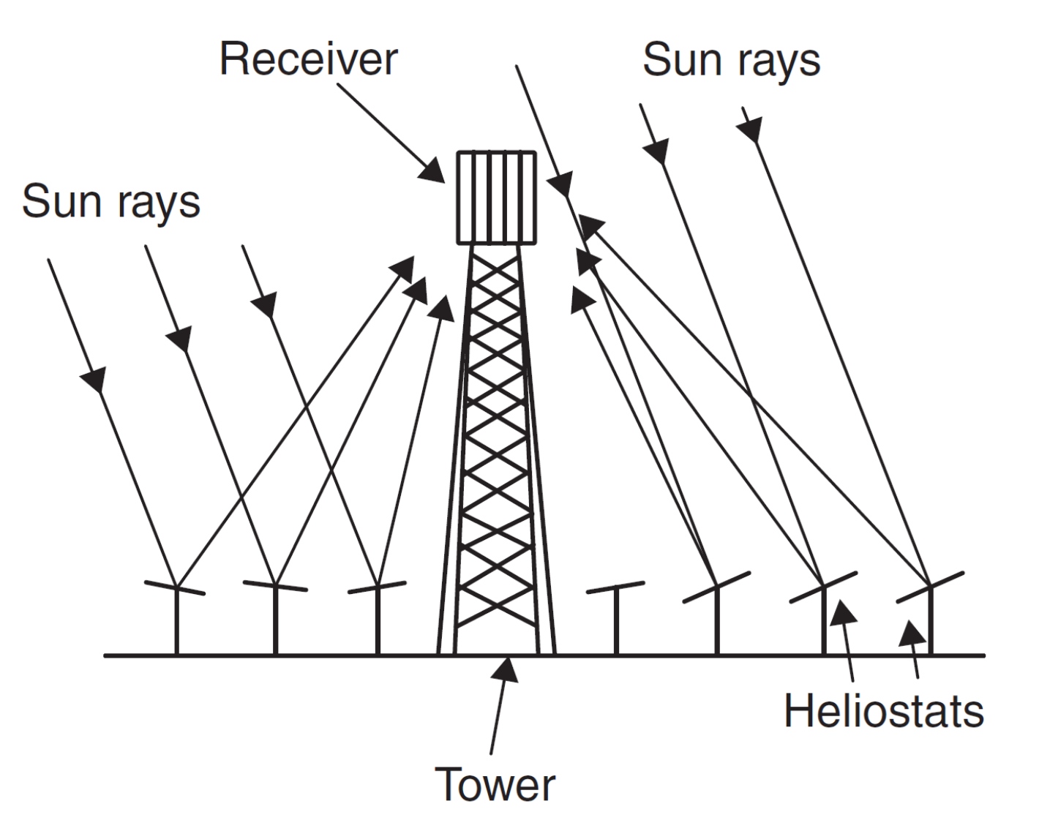
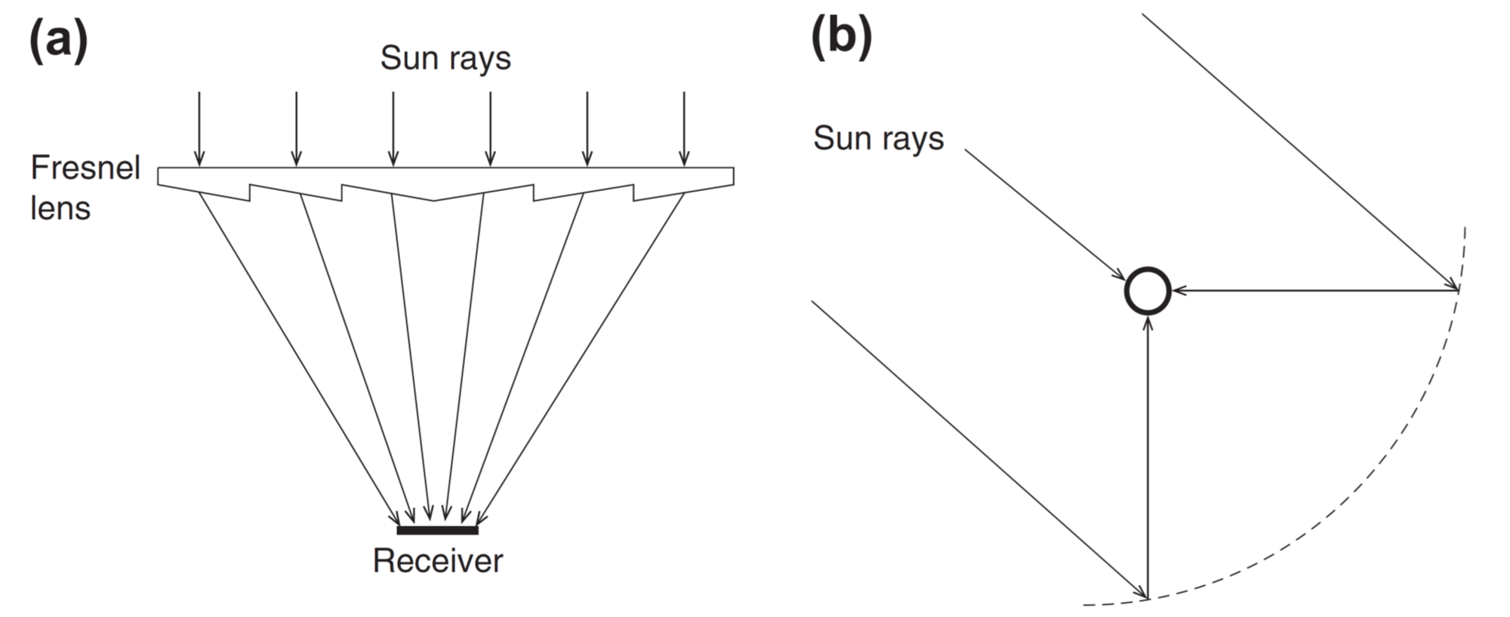

Slide 3
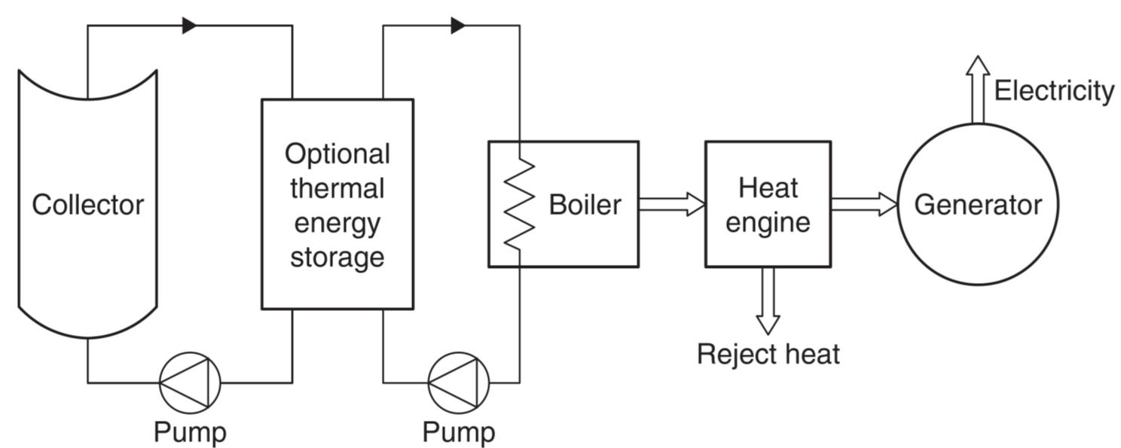
The main challenge in designing these systems is to select the correct operating temperature. This is because the efficiency of the heat engine rises as its operating temperature rises, whereas the efficiency of the solar collector reduces as its operating temperature rises. Concentrating solar collectors are used exclusively for such applications because the maximum operating temperature for flat-plate collectors is low relative to the desirable input temperature for heat engines, and therefore system efficiencies would be very low.

